Slide 1
Capstone – Predicting Fraudulent Transactions
By, josh thomason

Slide 2

Problem/objective
Create a model to predict fraudulent credit card transactions
Major problem for customers of banks or credit unions.
Especially troublesome if left unchecked and can compound to a much larger problem.
Lowers customer's trust.

Slide 3

Data Set
Around 280,000 credit transactions from Europe in 2013
Independent variables
‘Time’ - Seconds amassed since first purchase
‘Amount’ – transaction price
‘V1-V28’ – principal components, obtained beforehand
Dependent variable (what we are predicting on)
‘Class’
0 = non-fraudulent,
1 = fraudulent
No need to convert to dummy variables.
No null values to contend with.

Slide 4
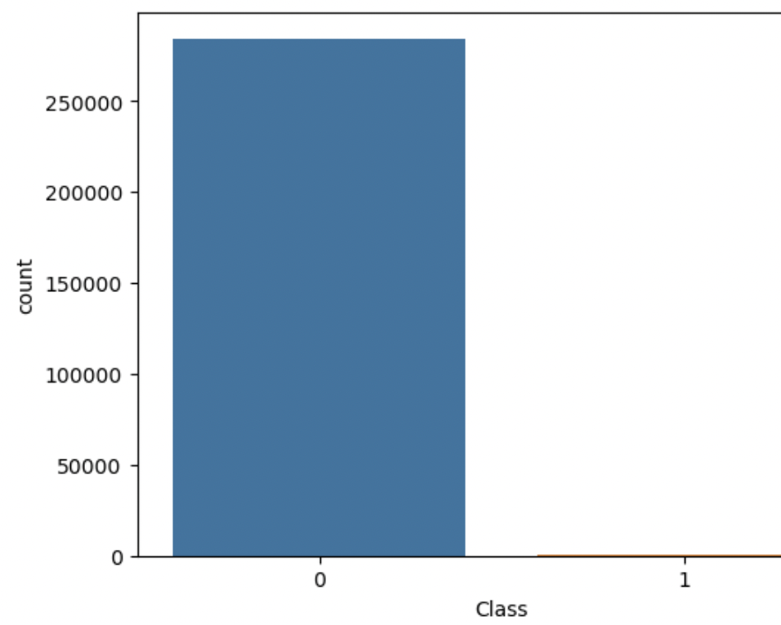
Visualizations: ‘Class’
'Class’ takes on one of two values
This is a highly imbalanced categorical dataset.
This will become something to contend with in the model building process

Slide 5
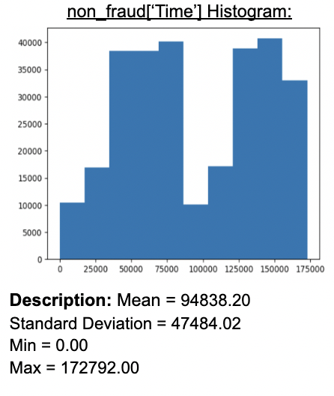
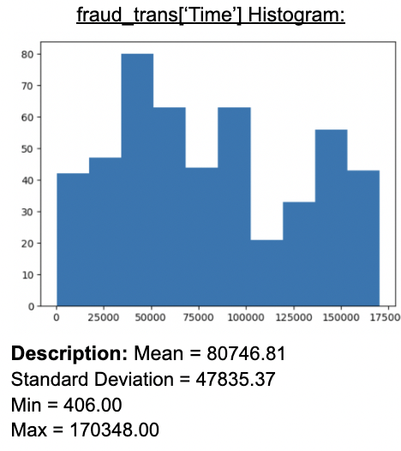
Visualizations: ‘Time’
Hard to decipher a major difference graphically.
Delve deeper with the descriptions of the variables.
Fraudulent transactions on average have a lower time component between transactions.
With similar standard deviations
A meaningful variable to keep for model building.

Slide 6
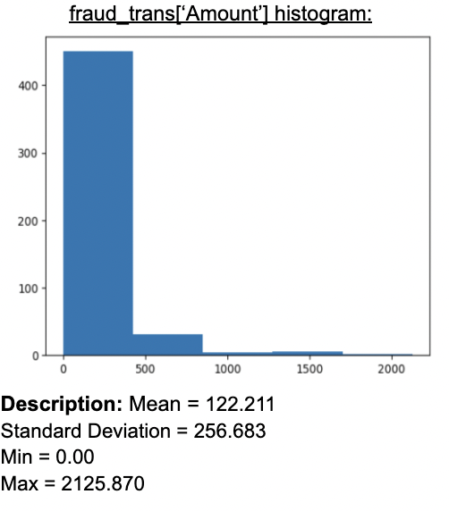
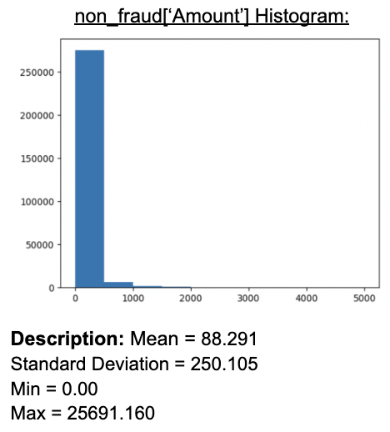
Visualizations: ‘Amount’
Hard to decipher graphically.
Again, delve deeper with the variable descriptions.
Fraudulent transactions on average are of a higher amount than non-fraudulent.
Similar standard deviations
Again, an important variable to keep for model building.

Slide 7

Model Building: Part 1
3 models
KNN, Random Forest, Logistic Regression
Standardized our independent variables (X_train).
Random Search CV to find best parameters for each model.
Then fit with the X & Y training sets.
ROC–AUC scores:
KNN – 0.912
Random Forest – 0.895
Logistic Regression – 0.80

Slide 8
Problems with the first models
Problem 1: metric scores were not as high as we wanted even though we optimized our parameters for each model.
Problem 2: Our dependent variable (‘Class’) is so imbalanced it makes our predictions harder to train a model around.
Solution:
Resampling:
resample our data to create a more balanced dataset to train our model with.

Slide 9
Under-sampling method: RandomUndersampler
Resample on our X_train and y_train sets.
Equal amount of data points for our ‘Class’ column values (0 & 1).
Under samples:
Brings the number of points down to match the amount in class 1.
New ‘Class’ amounts:
Class 0: 377
Class 1: 377

Slide 10
Oversampling Method: SMOTE
Again, resample on our X_train and y_train sets.
Same thing as the under-sampling method, makes the two values of our ‘Class’ column equal.
Oversamples:
Brings class 1 values up to match the number in class 0.
New ‘Class’ amounts:
Class 0: 213,228
Class 1: 213,228

Slide 11
Model Building: Part 2
Used the new resampled training sets using the RandomUnderSampler method.
Used a grid search (fit with the resampled sets) this time to find the best parameters for each model.
Fit the models to the new training sets.
ROC-AUC scores:
KNN – 0.984
Random Forest – 0.987
Logistic Regression – 0.986 (much simpler than Random Forest)

Slide 12
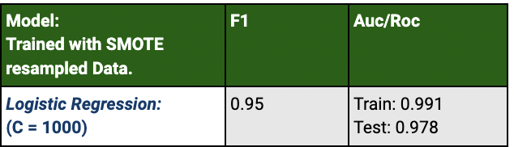
Model Building: Part 3
Used the new resampled training sets using the SMOTE oversampling method.
Found that both KNN and Random Forest models were to computationally expensive to train with this set.
The only one that was simple o enough and time efficient was the Logistic Regression model.
Used the grid search (fit with the SMOTE resampled training sets) again to find the best parameters.
Fit the model
ROC-AUC score:
Logistic Regression – 0.991

Slide 13

Findings:
It is necessary to use a resampling method to build a reliable model.
The under-sampling method is much simpler and is less computationally expensive.
The Logistic Regression model’s I built perform at a high level, while also taking less time to train/run.

Slide 14
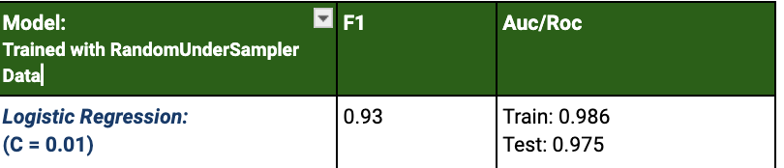
Recommendations: Smaller business
Logistic Regression, C = 0.01 (RandomUnderSampler)
High predictive capability (roc_auc_score = 0.986)
Less computationally expensive, requires less resources
Because of smaller size, can go through and verify transactions flagged as fraudulent

Slide 15
Recommendations: Larger business
Logistic Regression, C = 1000 (SMOTE over sampling method)
Highest predictive capability of all models (roc_auc_score = 0.991)
More computationally expensive, takes more time/resources to test and train.
Doable for bigger companies
Due to a large customer base, can email/text or call, based on if a transaction was flagged as fraudulent
Saves time and makes it possible to cover more customers and transactions.

